Slide 1
ABCA4 Responsible Stargardt Disease
Presented By: Timothy Biewer-Heisler

Slide 2
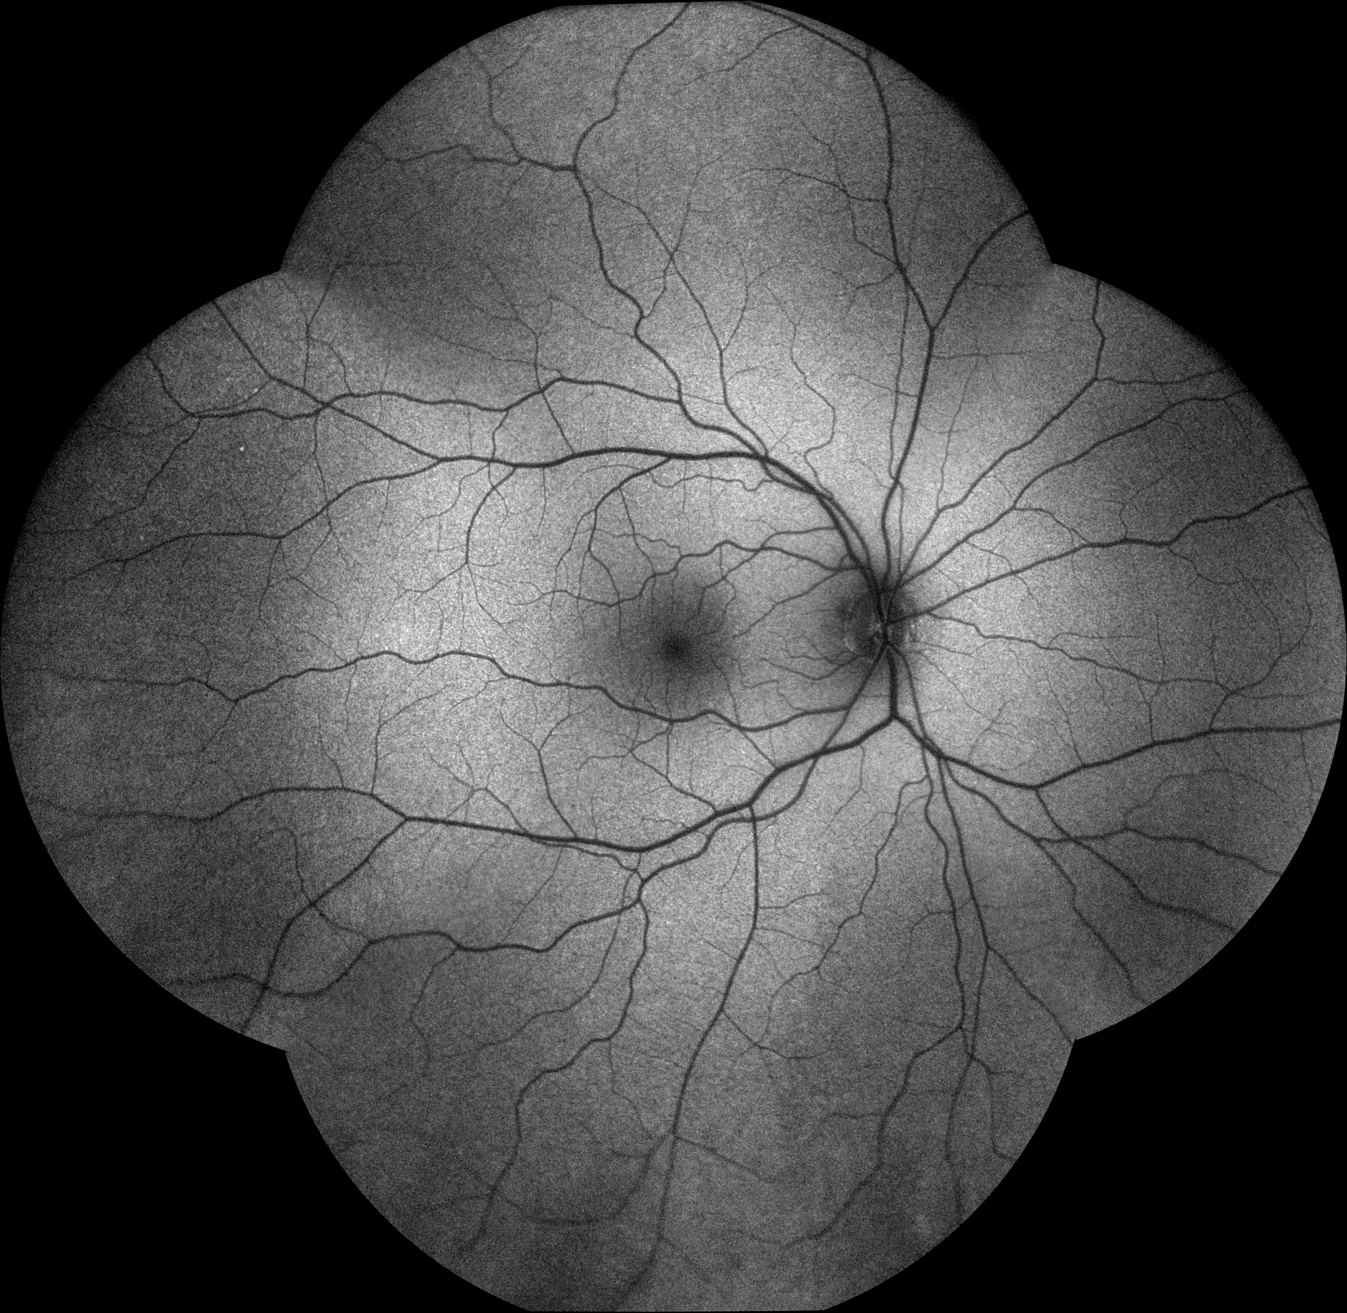
What is Stargardt Disease?

Slide 3
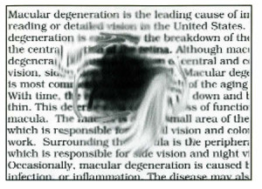
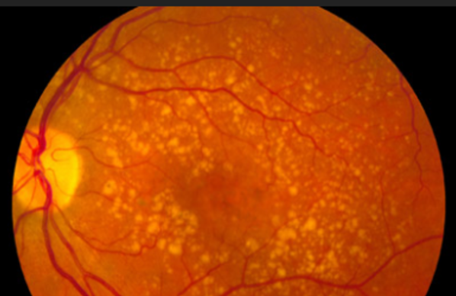
What are the Symptoms of Stargardt Disease?
Loss of central vision
Yellow-white spots on retina
Colorblindness and eventual complete vision loss

Slide 4
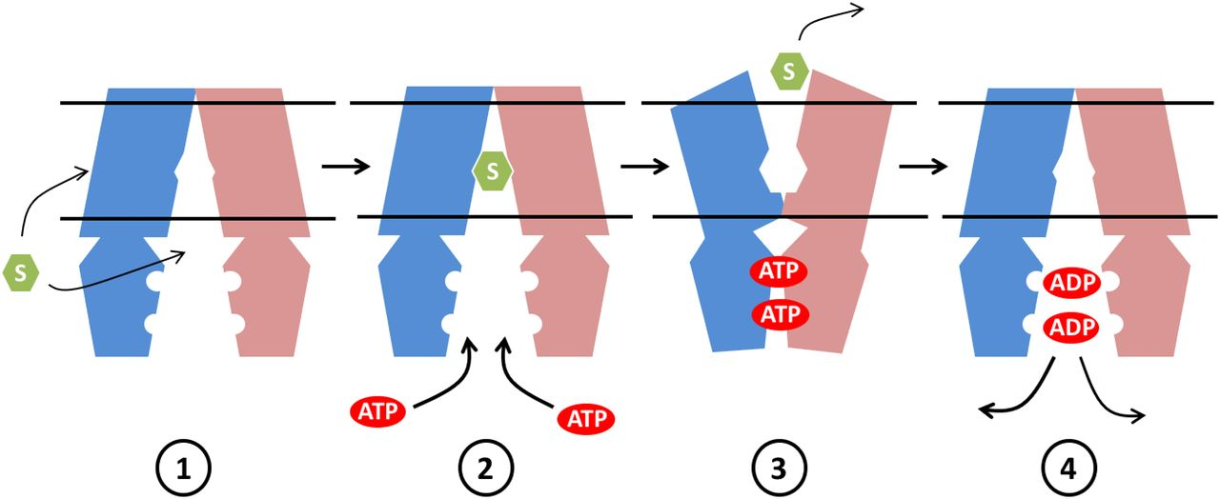
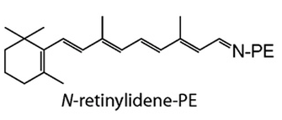
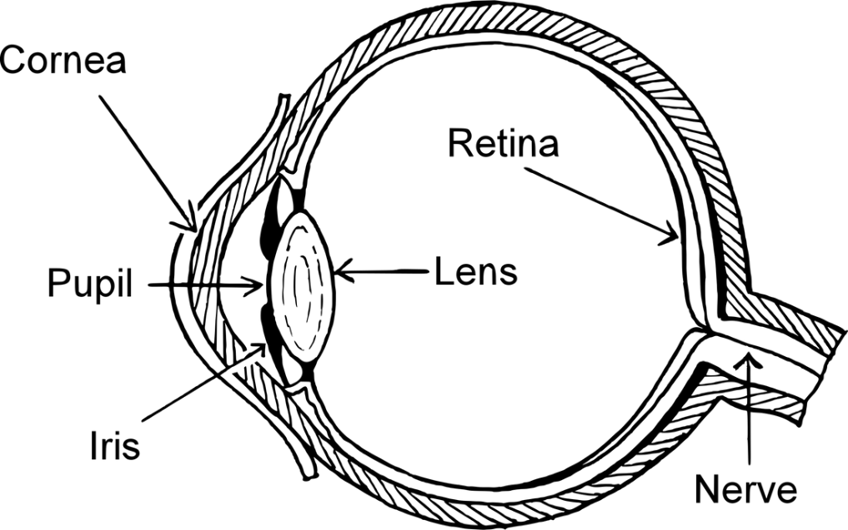
ABCA4 Gene
Human
2273 AA
ABC2 Membrane 3:
Unknown region:
Transmembrane region:
AAA ATPase:
ATP-Binding Cassette
Chemical Removal
Operates in the Retina

Slide 5
ABCA4 Homologs
Human
2273 AA
Bonobo
2159 AA
99%
Mouse
2310 AA
87%
Zebrafish A
2277 AA
63%
Zebrafish B
2327 AA
63%
C. Elegans
1564 AA
27%
Similar to ABC2 Membrane 3
D. Melanogaster
388 AA
29%
Transmembrane region:
AAA ATPase:
Unknown region:
ABC2 Membrane 3:

Slide 6
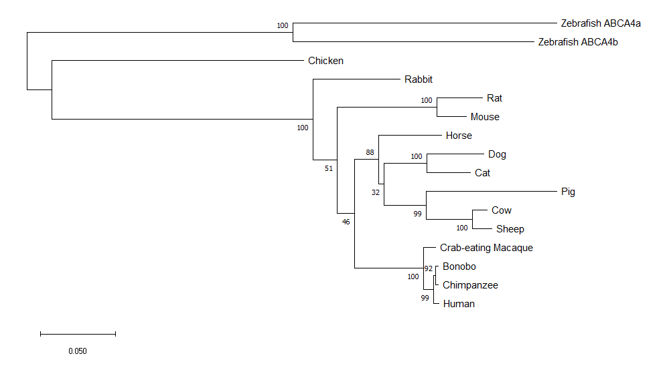
How are ABCA4 Homologs Related?

Slide 7
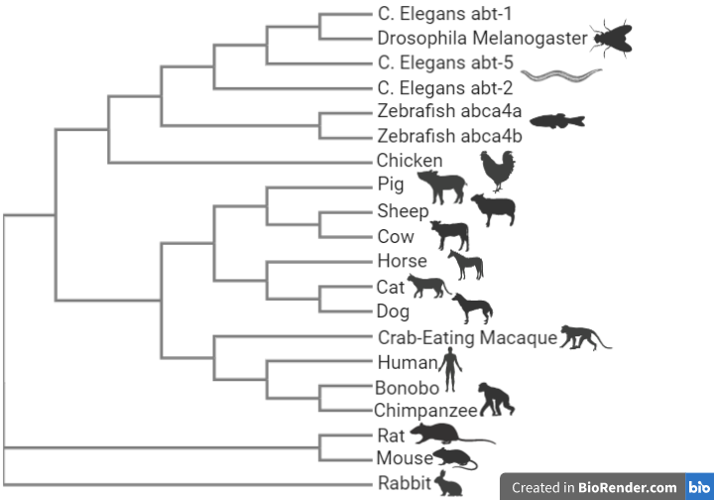
Clustal Omega ABCA4 Phylogeny

Slide 8
Image References
https://130529218-701413549797869494.preview.editmysite.com/uploads/1/3/0/5/130529218/599754248.jpg
https://www.centervue.com/wp-content/uploads/2017/07/image1.jpg
https://completeeyecare.com/wp-content/uploads/2013/09/SKMBT_C36013111815130-300x217.jpg
https://cdn.arstechnica.net/wp-content/uploads/2017/03/retina-age-related-macular-degeneration-600x538.png
https://media.npr.org/assets/img/2016/03/02/amd-b2ba911d887ba542c6ae64d84ab008d7f0992d8b-s800-c85.jpg
http://www.plantphysiol.org/content/plantphysiol/178/1/18/F5.large.jpg
https://130529218-701413549797869494.preview.editmysite.com/uploads/1/3/0/5/130529218/323989721.png

